Slide 1


<Cheung Chung Hon>
<31/7/2023>

Slide 2

Outline
Executive Summary
Introduction
Methodology
Results
Conclusion
Appendix

Slide 3
Executive Summary
Summary of all Methodology
Collection the data from SpaceX and Web scraping(public data)
Machine Learning Prediction
Exploratory Data Analysis (EDA)
Summary of all results

Slide 4
Introduction
Project background and context
Problems you want to find answers

Slide 5

Section 1

Slide 6
Methodology
Executive Summary
Data collection methodology:
The data
Perform data wrangling
Describe how data was processed
Perform exploratory data analysis (EDA) using visualization and SQL
Perform interactive visual analytics using Folium and Plotly Dash
Perform predictive analysis using classification models
How to build, tune, evaluate classification models

Slide 7
Data Collection
• Data sets were collected from Space X API (https://api.spacexdata.com/v4/rockets/) and
from Wikipedia (https://en.wikipedia.org/wiki/List_of_Falcon/_9/_and_Falcon_Heavy_launches), using web scraping technics.

Slide 8
Data Collection – SpaceX API
SpaceX is a public API where the data can be used
• Source code: https://github.com/hgpskelvin/final/blob/908c36b2b887148e271a8f602db88ac79069eb76/jupyter-labs-spacex-data-collection-api.ipynb
Request API and parse the SpaceX launch data
Filter data to only include Falcon 9 launches

Slide 9
Data Collection - Scraping
Data from SpaceX launches(Wikipedia)
Data are downloaded from Wikipedia according to the flowchart and then persisted.
• Source code: https://github.com/hgpskelvin/final/blob/908c36b2b887148e271a8f602db88ac79069eb76/jupyter-labs-spacex-data-collection-api.ipynb
Request the Falcon9 Launch Wiki
Extract all column/variable names from the HTML table header
Create a data frame by parsing the launch HTML tables

Slide 10
Data Wrangling
First, exploratory data analysis by load from SpaceX dataset.
Then, Calculate some Exploratory Data Analysis (EDA) data.
Base on number and occurrence of launches on each site,
Finally, base on the outcome to label on the outcome column
Source code: https://github.com/hgpskelvin/final/blob/main/IBM-DS0321EN-SkillsNetwork_labs_module_1_L3_labs-jupyter-spacex-data_wrangling_jupyterlite.jupyterlite.ipynb

Slide 11
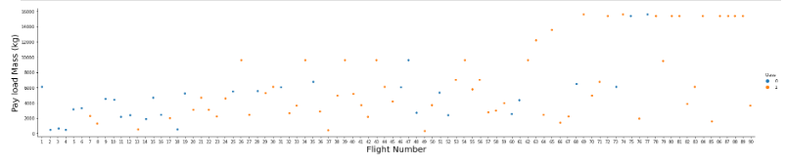
EDA with Data Visualization
To explore data, use the scatterplots and barplots to visualize the relationship between pair of features.
Payload Mass X Flight Number
Launch Site X Flight Number
Launch Site X Payload Mass
Orbit and Flight Number
Payload and Orbit
Souse: https://github.com/hgpskelvin/final/blob/main/IBM-DS0321EN-SkillsNetwork_labs_module_2_jupyter-labs-eda-dataviz.ipynb.jupyterlite.ipynb

Slide 12
EDA with SQL
The following SQL queries were performed:
the names of the unique launch sites in the space mission
Top 5 records where launch sites begin with the string 'CCA'
the total payload mass carried by boosters launched by NASA (CRS)
average payload mass carried by booster version F9 v1.1
the date when the first successful landing outcome in ground pad was acheived.
the names of the boosters which have success in drone ship and have payload mass greater than 4000 but less than 6000
the total number of successful and failure mission outcomes
the names of the booster_versions which have carried the maximum payload mass.
the failed landing_outcomes in drone ship, their booster versions, and launch site names for in year 2015
Rank the count of landing outcomes (such as Failure (drone ship) or Success (ground pad)) between the date 2010-06-04 and 2017-03-20, in descending order
Source code: https://github.com/hgpskelvin/final/blob/main/jupyter-labs-eda-sql-coursera_sqllite.ipynb

Slide 13
Build an Interactive Map with Folium
First,Mark all launch sites on a map
Add each site's location on a map using site's latitude and longitude coordinates
create a folium Map object and Mark the success/failed launches for each site on the map
Then, Calculate the distances between a launch site to its proximities
Source code: https://github.com/hgpskelvin/final/blob/main/IBM-DS0321EN-SkillsNetwork_labs_module_3_lab_jupyter_launch_site_location.jupyterlite.ipynb

Slide 14
Add a callback function to render success-pie-chart based on selected site dropdown
Build a Dashboard with Plotly Dash
Add a Launch Site Drop-down Input Component
Add a callback function to render pie chart based on selected site dropdown
Add a Range Slider to Select Payload
Add a callback function to render the scatter plot
Source code: https://github.com/hgpskelvin/final/blob/main/spacex_dash_app.py

Slide 15
Predictive Analysis (Classification)
Base on the data to make a classification by confusion matrix and label the support vector object.
Use the method score to plot confusion matrix
Base on different mode method performs to make a bar plots to find the best one.(KNN,LogReg,SVM,Tree)
Code: https://github.com/hgpskelvin/final/blob/main/IBM-DS0321EN-SkillsNetwork_labs_module_4_SpaceX_Machine_Learning_Prediction_Part_5.jupyterlite.ipynb

Slide 16
Results
Exploratory data analysis results:
Space X uses 4 different launch sites;
The first launches were done to Space X itself and NASA;
The average payload of F9 v1.1 booster is 2,928 kg;
The first success landing outcome happened in 2015 fiver year after the first launch;
Many Falcon 9 booster versions were successful at landing in drone ships having payload above the average;
Almost 100% of mission outcomes were successful;
Two booster versions failed at landing in drone ships in 2015: F9 v1.1 B1012 and F9 v1.1 B1015;
The number of landing outcomes became as better as years passed

Slide 17
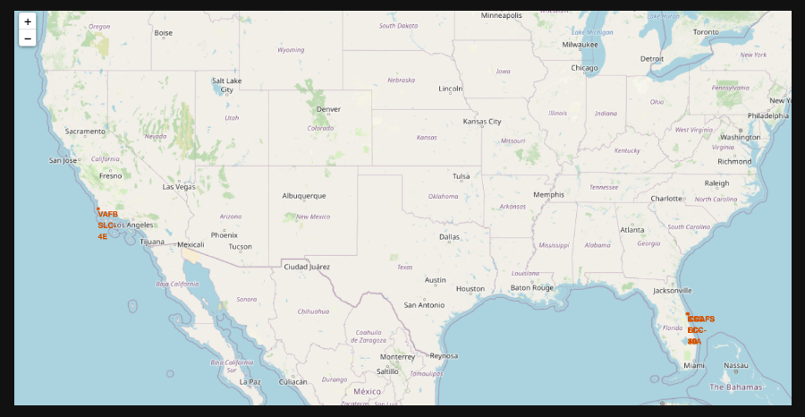
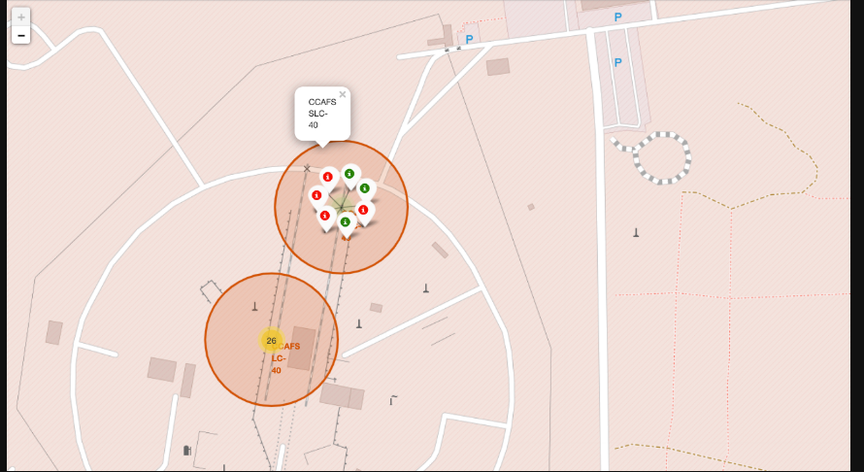

Slide 18
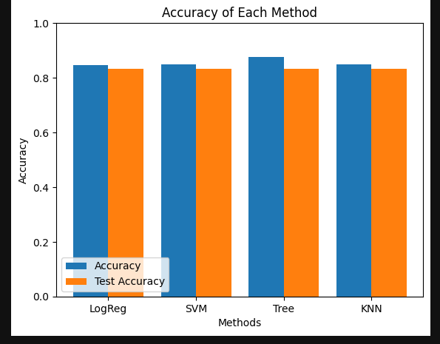
Results
Performance of different method,Clearly that Decision Tree Classifier is the best model to predict successful landings.

Slide 19

Section 2

Slide 20
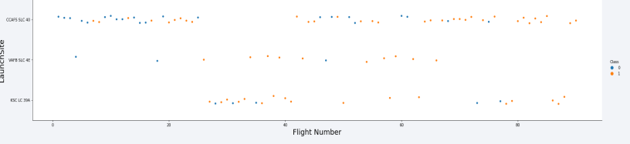
Flight Number vs. Launch Site
CCAF5 SLC 40 is the best launch site where most of recent launches were successful;
2nd is VAFB SLC 4E and 3rd is KSC LC 39A.

Slide 21
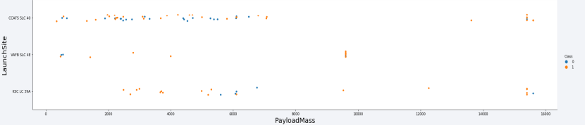
Payload vs. Launch Site
over 9,000kg (about the weight of a school bus) have excellent success rate of Payloads;
Only CCAFS SLC 40 and KSC LC 39A launch sites have over 12,000kg on Payloads.

Slide 22
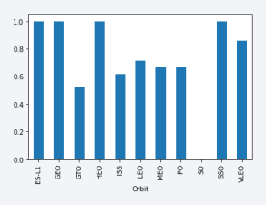
Success Rate vs. Orbit Type
The highest success rates happens to orbits:
• ES-L1;
• GEO;
• HEO; and
• SSO.
• Followed by:
• VLEO (above 80%); and
• LFO (above 70%).

Slide 23
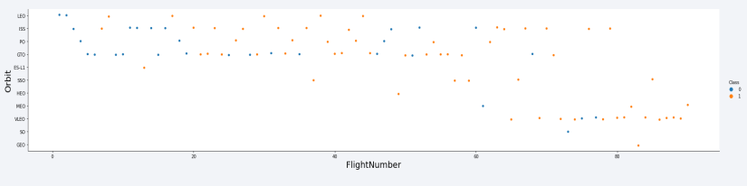
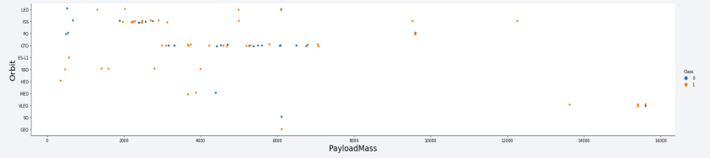
Flight Number vs. Orbit Type
success rate increase over time to all orbits

Slide 24
Payload vs. Orbit Type
There are no relation between payload and success rate to orbit GTO.

Slide 25
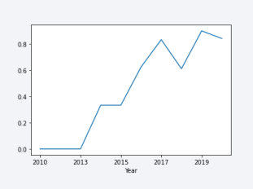
Launch Success Yearly Trend
Success Year rate started increasing in 2013 and kept until 2020
The first three years appear to be a period of technical adjustment and improvement.

Slide 26
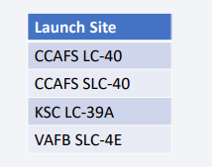
All Launch Site Names
There are four launch sites:

Slide 27
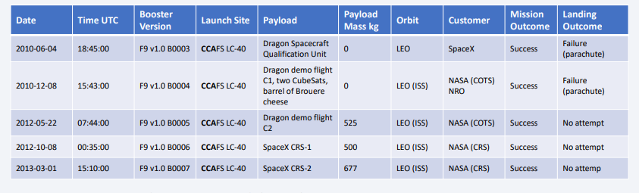
Launch Site Names Begin with 'CCA'
Find 5 records where launch sites begin with `CCA`
Use the SQL to find out 5 records where launch sites begin with `CCA`

Slide 28
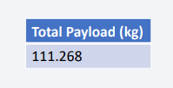
Total Payload Mass
The total payload carried by boosters from NASA
Summing all payloads whose codes contain’CRS’ which mean to NASA

Slide 29
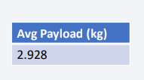
Average Payload Mass by F9 v1.1
Average payload mass carried by booster version F9 v1.1
Filtering data by the booster version above and calculating the average payload mass we obtained the value of 2,928 kg.

Slide 30
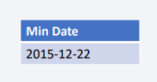
First Successful Ground Landing Date
Dates of the first successful landing outcome on ground pad:
By filtering data by successful landing outcome on ground pad, we get the minimum date is 2015-12-22

Slide 31
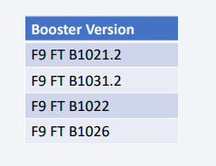
Successful Drone Ship Landing with Payload between 4000 and 6000
List of names of boosters which have successfully landed on drone ship and had payload mass greater than 4000 but less than 6000
Selecting distinct name of booster versions.

Slide 32
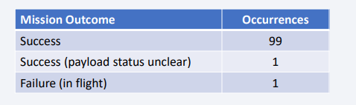
Total Number of Successful and Failure Mission Outcomes
Total number of successful and failure mission outcomes
Selecting the data group by mission outcomes and counting the records for each group.

Slide 33
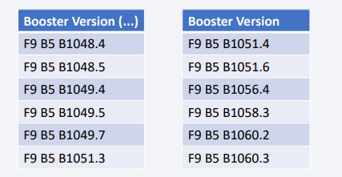
Boosters Carried Maximum Payload
Booster which have carried the maximum payload mass
These are the boosters which have maximum payload mass.

Slide 34
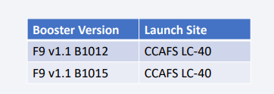
2015 Launch Records
List of the failed landing outcomes in drone ship, their booster versions, and launch site names for in year 2015
Only two are failed in 2015.

Slide 35
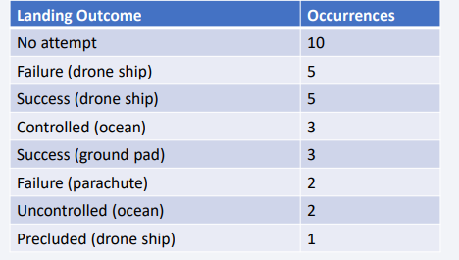
Rank Landing Outcomes Between 2010-06-04 and 2017-03-20
Ranking of all landing outcomes (such as Failure (drone ship) or Success (ground pad)) between the date 2010-06-04 and 2017-03-20, in descending order
Most of a data which is No attempt also will be account to make sure the data and the SQL code is correct.

Slide 36

Section 3

Slide 37
<Folium Map Screenshot 1>
Replace <Folium map screenshot 1> title with an appropriate title
Explore the generated folium map and make a proper screenshot to include all launch sites’ location markers on a global map
Explain the important elements and findings on the screenshot

Slide 38
<Folium Map Screenshot 2>
Replace <Folium map screenshot 2> title with an appropriate title
Explore the folium map and make a proper screenshot to show the color-labeled launch outcomes on the map
Explain the important elements and findings on the screenshot

Slide 39
<Folium Map Screenshot 3>
Replace <Folium map screenshot 3> title with an appropriate title
Explore the generated folium map and show the screenshot of a selected launch site to its proximities such as railway, highway, coastline, with distance calculated and displayed
Explain the important elements and findings on the screenshot

Slide 40

Section 4

Slide 41
<Dashboard Screenshot 1>
Replace <Dashboard screenshot 1> title with an appropriate title
Show the screenshot of launch success count for all sites, in a piechart
Explain the important elements and findings on the screenshot

Slide 42
<Dashboard Screenshot 2>
Replace <Dashboard screenshot 2> title with an appropriate title
Show the screenshot of the piechart for the launch site with highest launch success ratio
Explain the important elements and findings on the screenshot

Slide 43
<Dashboard Screenshot 3>
Replace <Dashboard screenshot 3> title with an appropriate title
Show screenshots of Payload vs. Launch Outcome scatter plot for all sites, with different payload selected in the range slider
Explain the important elements and findings on the screenshot, such as which payload range or booster version have the largest success rate, etc.

Slide 44

Section 5

Slide 45
Classification Accuracy
Visualize the built model accuracy for all built classification models, in a bar chart
Find which model has the highest classification accuracy

Slide 46
Confusion Matrix
Show the confusion matrix of the best performing model with an explanation

Slide 47
Conclusions
Point 1
Point 2
Point 3
Point 4
…

Slide 48
Appendix
Include any relevant assets like Python code snippets, SQL queries, charts, Notebook outputs, or data sets that you may have created during this project

Slide 49


